Slide 1
User Search Techniques

Slide 2
User Search Techniques
Search Statements and Binding
Similarity Measures and Ranking
Relevance Feedback
Selective Dissemination of Information Search
Weighted Searches of Boolean Systems
Searching the INTERNET and Hypertext

Slide 3
Information Visualization
Introduction to Information Visualization
Cognitive and Perception
Information Visualization Technologies

Slide 4
Search Statements and Binding
Search statements are the statements of an information need generated by users to specify the concepts they are trying to locate in items.
The search statement uses traditional Boolean logic and/or Natural Language. In generation of the search statement, the user may have the ability to weight (assign an importance) to different concepts in the statement.

Slide 5
Cont…
The binding is to the vocabulary and past experiences of the user.
The next level of binding comes when the search statement is parsed for use by a specific search system.
The final level of binding comes as the search is applied to a specific database.

Slide 6
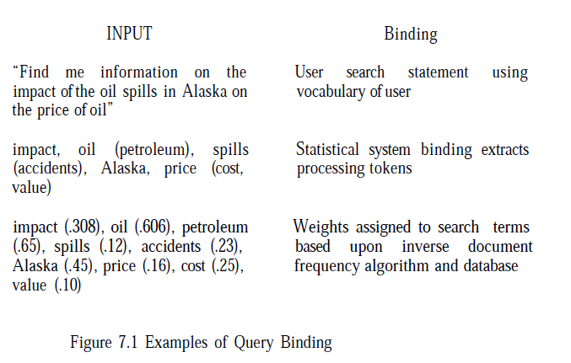
Conti…

Slide 7
Conti…
The length of search statements directly affect the ability of Information Retrieval Systems to find relevant items.
The longer the search query, the easier it
is for the system to find items.
Selective Dissemination of Information systems are usually very long, typically 75 to 100 terms.

Slide 8
Similarity Measures and Ranking
Searching in general is concerned with calculating the similarity between a user’s search statement and the items in the database.
Restricting the similarity measure to passages gains significant precision with minimal impact on recall.
Once items are identified as possibly relevant to the user’s query, it is best to present the most likely relevant items first- Ranking
is a scalar number that represents how similar an item is to the query.

Slide 9



Similarity measure
To determine the similarity between documents for clustering purposes is:

Slide 10
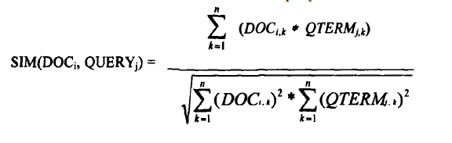
Similarity formula by Salton in SMART system
To determine the “weight” an item has with respect to the search statement, the Cosine formula is used to calculate the distance
between the vector for the item and the vector for the query:

Slide 11
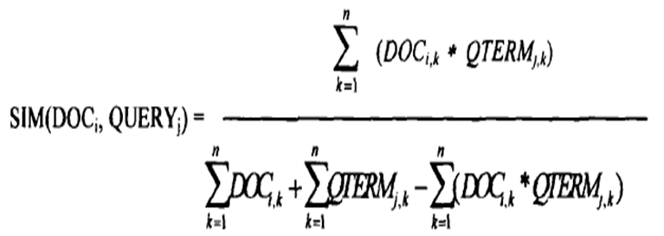
The Jaccard formula is:
The denominator becomes depend uponthe no of terms in common.
Common elements common increase, the similarity value quickly decreases, in the range -1 and +1.

Slide 12
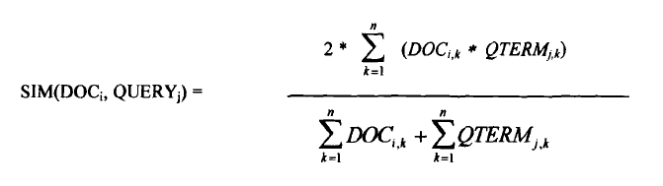
The Dice:
measure simplifies the denominator from the Jaccard measure and introduces a factor of 2 in the numerator.
The normalization in the Dice formula is also invariant to the number of terms in common.

Slide 13
Use of a similarity algorithm returns the complete data base as search results.
Many of the items have a similarity close or equal to zero.
Thresholds(default is the similarity > zero) are usually associated with the search process.
The threshold defines the items in the resultant Hit file from the query.
Thresholds are either a value that the similarity measure must equal or exceed or a number that limits the number of items in the Hit file.

Slide 14
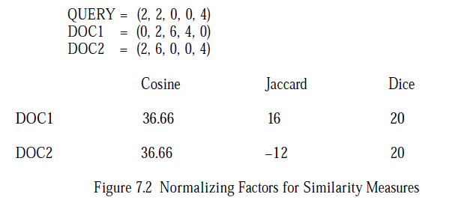
Normalizing denominator results vary with commonality of terms.

Slide 15
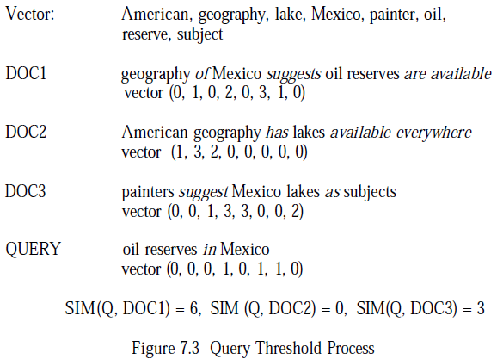
If threshold = 4 only Doc1 is selected
If threshold = 4 all selected

Slide 16
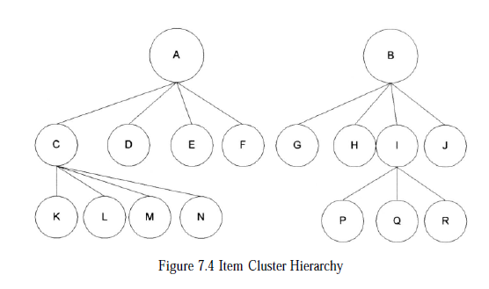
The items are stored in clusters.(TOP-DOWN)
A, B, C, I – centroids amd K to N, P, Q, R-ITEMS
The query is compared to the centroids “A” and “B.” If the results of the similarity measure are above the threshold, the query is then applied to the nodes’ children.

Slide 17
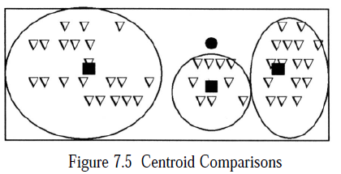
Conti…
The filled circle represents the query and the filled boxes represent the centroids for the three clusters represented by the ovals.

Slide 18


Hidden Markov Models Techniques

Slide 19
Ranking Algorithms
Ranking Algorithms

Slide 20
Relevance Feedback
Thesuari and semantic networks provide utility in generally expanding a user’s search statement to include potential related search terms.
But this still does not correlate to the vocabulary used by the authors that contributes to a particular database.
There is also a significant risk that the thesaurus does not include the latest jargon being used, acronyms or proper nouns.
In an interactive system, users can manually modify an inefficient query or have the system automatically expand the query via a thesaurus.

Slide 21
Relevant items (or portions of relevant items) are used to reweight the existing query terms and possibly expand the user’s search statement with new terms.
The relevance feedback concept was that the new query should be based on the old query modified to increase the weight of terms in relevant items and decrease the weight of terms that are in non-relevant items.

Slide 22
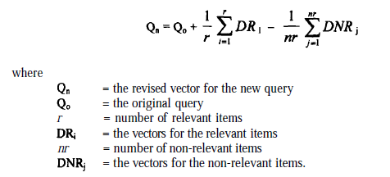
The formula used is:

Slide 23

This led to the revised version of the formula:
are the constants associated with each factor (usually 1/n or 1/nr times a constant).
Positive feedback is weighted significantly greater than negative feedback.
+ve feedback -ve feedback

Slide 24
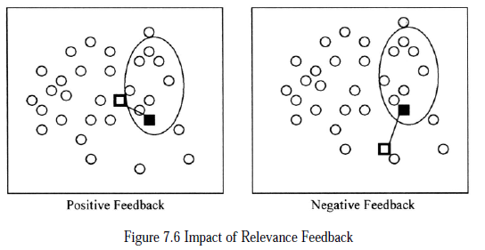

Slide 25
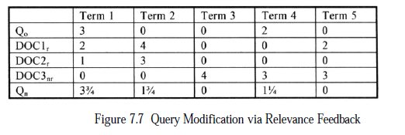



Slide 26
Selective Dissemination of Information Search
Selective Dissemination of Information, frequently called dissemination systems, are becoming more prevalent with the growth of the Internet.
A dissemination system is sometimes labeled a “push” system while a search system is called a “pull” system.
In a dissemination system, the user defines a profile and as new info is added to the system it is automatically compared to the user’s profile.
If it is considered a match, it is asynchronously sent to the user’s “mail” file.

Slide 27
The differences between the two functions lie in the dynamic nature of the profiling process, the size and diversity of the search statements and number of simultaneous searches per item.
In the search system, an existing database exists.
As such, corpora statistics exist on term frequency within and between terms.
These can be used for weighting factors in the indexing process and the similarity comparison (e.g., inverse document frequency algorithms).

Slide 28
Conti…
Profiles are relatively static search statements that cover a diversity of topics.
Rather than specifying a particular information need, they usually generalize all of the potential information needs of a user.
One of the first commercial search techniques for dissemination was the Logicon Message Dissemination System (LMDS). The system originated from a system created by Chase, Rosen and Wallace (CRW Inc.). It was designed for speed to support the search of thousands of profiles with items arriving every 20 seconds.

Slide 29
It demonstrated one approach to the problem where the profiles were treated as the static database and the new item acted like the query.
It uses the terms in the item to search the profile structure to identify those profiles whose logic could be satisfied by the item.
The system uses a least frequently occurring trigraph (three character) algorithm that quickly identifies which profiles are not satisfied by the item.
The potential profiles are analyzed in detail to confirm if the item is a hit.

Slide 30
Another example of a dissemination approach is the Personal Library Software (PLS) system. It uses the approach of accumulating newly received items into the database and periodically running user’s profiles against the database.
This makes maximum use of the retrospective search software but loses near real time delivery of items.
This makes maximum use of the retrospective search software but loses near real time delivery of items.

Slide 31
Another approach to dissemination uses a statistical classification technique and explicit error minimization to determine the decision criteria for selecting items for a particular profile.
Schutze et al. used two approaches to reduce the dimensionality: selecting a set of existing features to use or creating a new much smaller set of features that the original features are mapped into.

Slide 32

A x² measure was used to determine the
most important features. The test was applied to a table that contained the number
of relevant(Nᵣ)and non-relevant(Nᶯᵣ) items in which a term occurs plus the number of relevant and non-relevant items in which the term does not occur respectively).
The formula used was:

Slide 33
Weighted Searches of Boolean Systems
The two major approaches to generating queries are Boolean and natural language.
Natural language queries are easily represented within statistical models and are usable by the similarity measures discussed.

